Slide 1

Group-20
Multi-Label Text Classification
Using CNN-BiLSTM and CNN-BiGRU with GloVe Embeddings
Piyush Yadav
2020IMT-068
Aditya Pote
2020IMT-069
Prakhar Kumar Sinha
2020IMT-070

Slide 2

The Digital Information Surge: In today's digital era, the exponential increase in online content, including news articles, blogs, and social media posts, presents a significant challenge in categorizing and understanding vast amounts of text data efficiently.
Proposed Solution: This project explores enhancing multi-label text classification using CNN-BiLSTM and CNN-BiGRU models integrated with GloVe embeddings, aiming to leverage deep semantic understanding for better performance without the exhaustive training typically required.

Slide 3
Objectives
Accuracy Improvement
Effectiveness of GloVe Embeddings
Model Performance Comparison
The primary goal is to significantly enhance the accuracy of multi-label text classification. By integrating GloVe embeddings with advanced neural network architectures, we aim to achieve a more profound understanding of text semantics, leading to more precise classification outcomes.
We seek to demonstrate how pre-trained GloVe embeddings, with their rich representation of word meanings and relationships, can be effectively utilized to boost the performance of neural network models in handling complex text classification tasks.
This project undertakes a head-to-head comparison between the CNN-BiLSTM and CNN-BiGRU models, integrated with GloVe and without GloVe , to deduce which architecture more effectively classifies multi-label texts.

Slide 4



Literature Survey
Aspect | Evolution and Impact | Key Innovations and Models
Text Classification | Initially relied on rule-based models and SVMs for categorization. | Shift to deep learning models like RNNs and LSTMs for better sequential data processing.
Attention and CNNs | Attention mechanisms enhanced RNN capabilities by prioritizing relevant input segments. | CNNs adapted from visual tasks to text classification, focusing on local patterns.
Word Embeddings | Emergence of pre-trained embeddings like GloVe revolutionized text representation. | Enabled nuanced understanding of word semantics, improving classification accuracy.
Hybrid Modeling Approach | Combining the sequential processing of RNNs with the local pattern recognition of CNNs. | Development of hybrid models that utilize both RNNs and CNNs for superior performance in text classification.

Slide 5
Dataset Preparation and Preprocessing
01.
Methodology
Overview
02.
Intorduction to Embeddings and Models
Model Implementation with GloVe Embeddings
03.

Slide 6
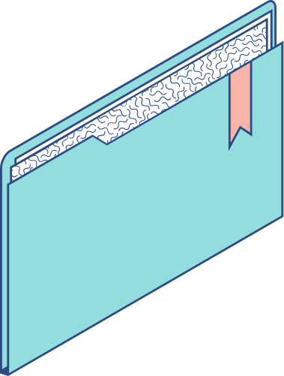
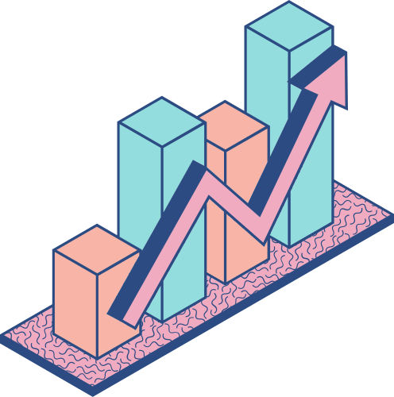
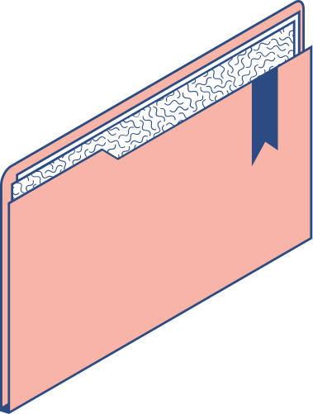
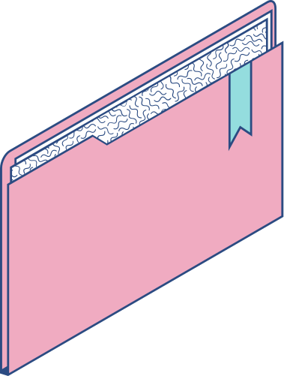
01.
Data Analysis and Preprocessing

Slide 7
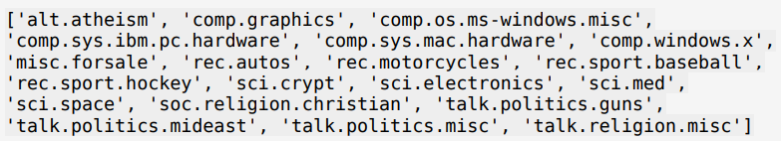
Dataset
20 Newsgroups Dataset from ScikitLearn Library.
Collection of 18828 newsgroup documents from 20 different newsgroups.
Common standard for training and testing performance of an algorithm for tasks such as multi-class text classification

Slide 8
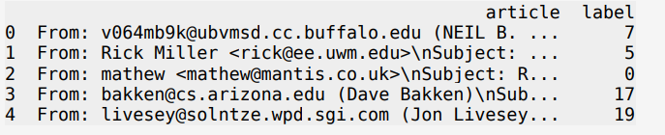
Dataset

Slide 9
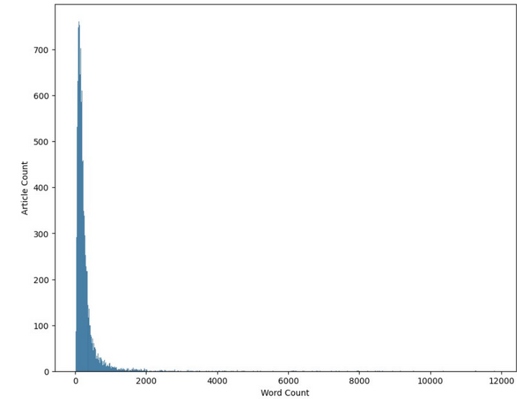
Exploratory Data Analysis
On performing an eda on our dataset, we had the following observations and conclusions:
Observation: Percentage of Articles having less than 1000 Words ~ 97%
Conclusion: Can truncate all the documents to the first 1000 words without losing any important information.

Slide 10
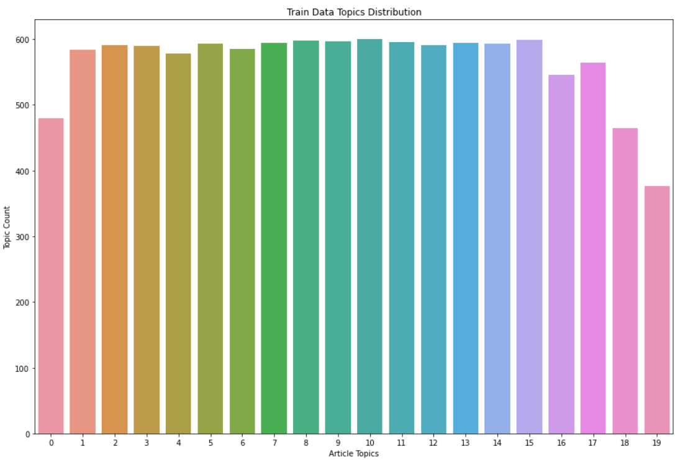
Observation: Class Distribution for 20Newsgroups Dataset
Conclusion: Balanced Dataset across the labels

Slide 11
Preprocessing
The following pre-processing steps were applied to clean the dataset and prepare it as input to our algorithm:
Remove leading and trailing spaces from each data point.
New line character substituted by spaces.
Convert all the data into lowercase .
Remove punctuations and special characters from every word
Remove stop words.
Remove words having less than 3 characters.
Lemmatize each token in the text using a WordNetLemmatizer which will convert each token based on its context within the text .

Slide 12
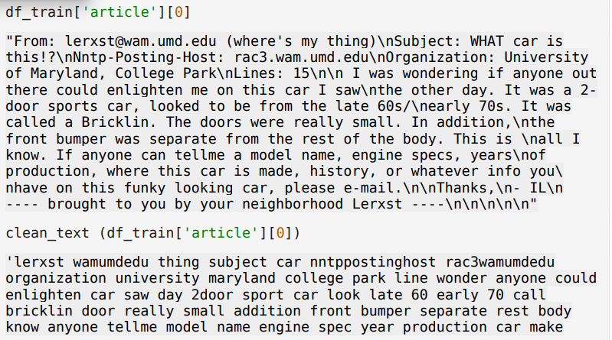
Preprocessing
We used nltk’s Parts of Speech Tagging to generate word net tags and using that tags, we lemmatized each word token based on the context and formed a string by concatenation of the tokens.

Slide 13
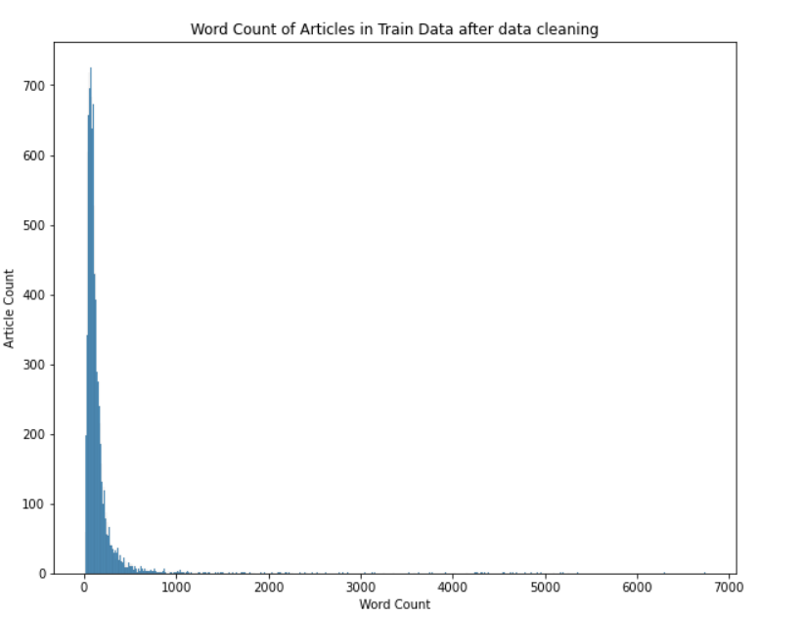
Preprocessing
After cleaning the dataset, we observed that the percentage of articles having less than 300 Words are almost 93%. For the sake of an informed inquiry depending on our computing resources, we truncated the articles to maintain a 300 word limit boundary.

Slide 14
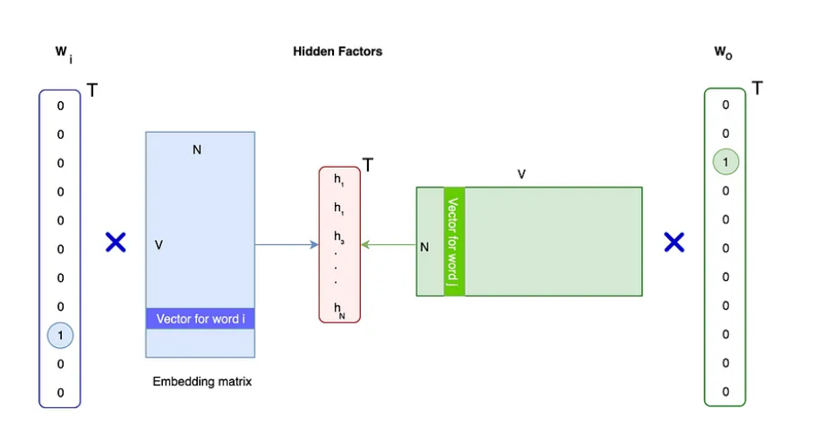
Word Embeddings
Word Embedding is a Deep Learning method in deriving vector representations for words. 2 words that are represented in an D-vector space as vectors must have a larger dot product.

Slide 15
Word Embeddings
SKIP-GRAM MODEL:
Given a word, predict its neighboring words in a text corpus.
For similar words, we move their vector representation closer. We want this pair to have the largest similarity over other combinational pairs involving the given word.
CBOW(Continous Bag Of Words):
We want to predict the target word given the context.

Slide 16
GloVe
Global Vectors for Word Representation(GloVe), is an unsupervised learning algorithm that generates vector representations, or embeddings, of words.
The GloVe model learns vectors from how frequently they appear together in large text corpus (co-occurence information). GloVe embeddings builds co-occurence matrix that highlights conditional probabilities of words occuring together given a context word.

Slide 17
GloVe Embeddings
GloVe Word Embeddings are the pretrained representation of each word into a mathematical vector using a large corpus of text. These mathematical vectors are then used to replace each word in an article or textual document.
Essentially, GloVe embeddings are used to convert textual information into a mathematical form which is then inputted into a deep learning network for further fine-tuning in the context of a specific application.
During training, GloVe ensures that similar words have embedding vectors that are close together, while different words have embedding vectors that are farther apart. This captures the semantic relationships between words.
Unlike some other word embedding methods, GloVe doesn't just look at the context of words, but also incorporates information about how often words co-occur in the training corpus. This helps the model learn meaningful representations.

Slide 18
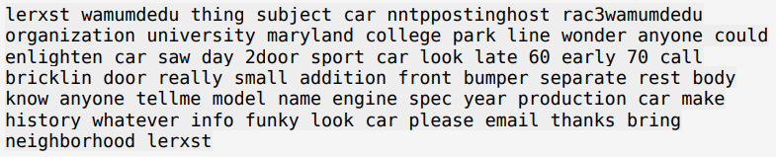

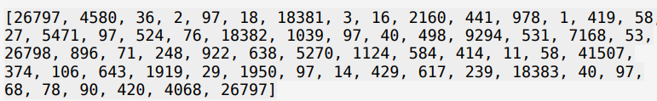
Word Tokenization
Processes all the individual tokens in the dataset articles.
Assign an ID to each unique token in the form of a dictionary.
Convert each article in the dataset such that each tokenized word is replaced by its mathematical index.

Slide 19
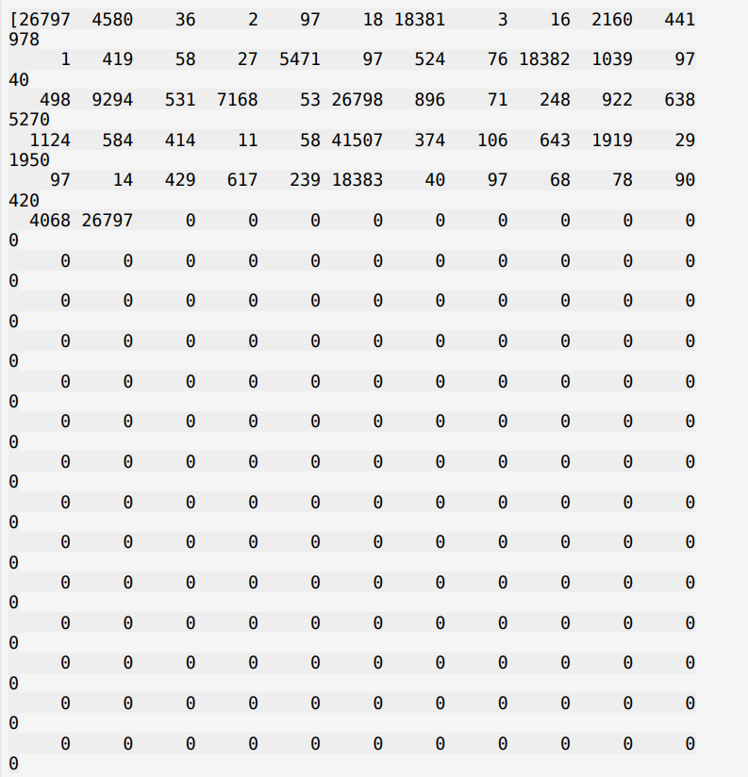
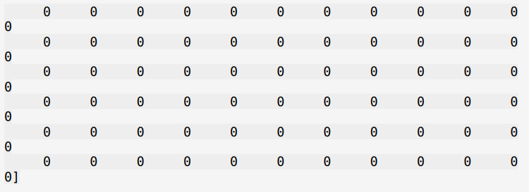
Word Tokenization
Apply post padding so that the encoded sequence has a fixed sequence length of 300.

Slide 20
02.
Multi-Class Text Classification

Slide 21
CNN-BiLSTM
Convolutional Neural Network:
Convolutional Neural Networks (CNN) have been extensively applied in image processing. With the evolution of word embedding and deep learning technologies, CNNs have also begun to cater to NLP tasks. The following are the steps involved in a convolutional layer:
Convolution: It is a mathematical combination of two relationships to produce a third relationship.
Convolution over input: We slide over word embedding the convolution to extract features by applying a filter. This is important in feature extraction. There are some parameters associated with that sliding filter:
Stride: Size of the step filter moves every instance of time.
Filter count: Number of filters we want to use.
Having generated multiple feature maps, an activation function is passed over the output to provide a non-linear relationship for our output.

Slide 22
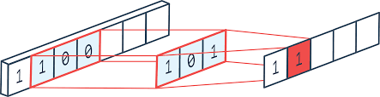
CNN
The purpose of this Conv1D layer is to extract local level features from the input sequence (Feature Extraction). This extracts a representative and effective feature by performing a one-dimensional convolution operation with multiple filters

Slide 23
CNN-BiLSTM
Bi-LSTM:
The Recurrent neural network model family generally performs better when modeling sequential data by using the output from the prior encounter as an input data source for the future.
What is RNN?
By feeding the output of one layer to itself and thus looping through the exact same layer multiple times, RNNs allow information to persist through the entire model.
LSTMs?
Long Short Term Memory networks (LSTMs) are capable of learning long-term dependencies. LSTMs are explicitly designed to avoid the long-term dependency problem. Connecting information among long periods of time is practically their default behavior.
Inside one LSTM module, the key component that allows information to transfer through the entire model is called the cell state. In addition to transferring information, the module has the ability to add or remove information to the cell state, which is regulated by structures called gates.

Slide 24
CNN-BiLSTM
It consists of three layers that interact with one another in a way to produce the output of that cell along with the cell state. These two things are then passed onto the next hidden layer.
LSTMs comprise three logistic sigmoid gates and one tanh layer. Gates have been introduced in order to limit the information that is passed through the cell.
Forget Gate:
The information that is no longer useful in the cell state is removed with the forget gate.
Input Gate:
The addition of useful information to the cell state is done by the input gate.
Output gate
The task of extracting useful information from the current cell state to be presented as output is done by the output gate

Slide 25
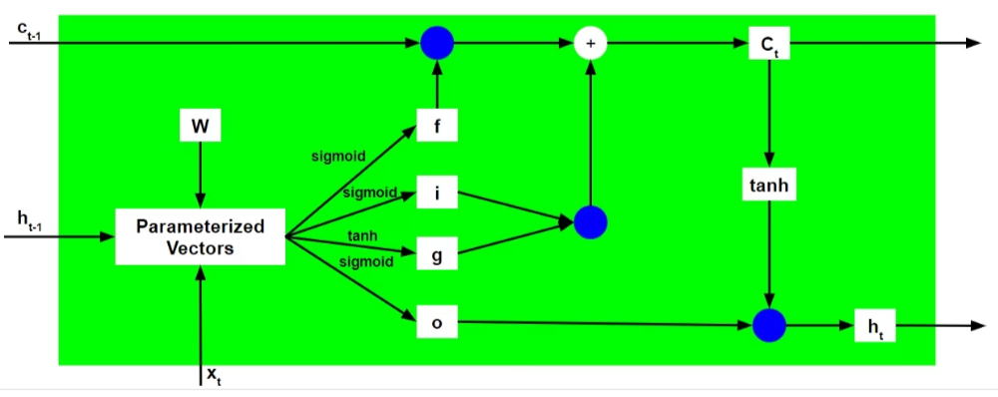
CNN-BiLSTM
LSTM uses separate paths for long-term memory and short-term memory and uses the three gates: forget gate, input gate, and output gate to regulate cell state so that it tackles RNN’s long-term dependency issues by filtering useless information out of the network.

Slide 26
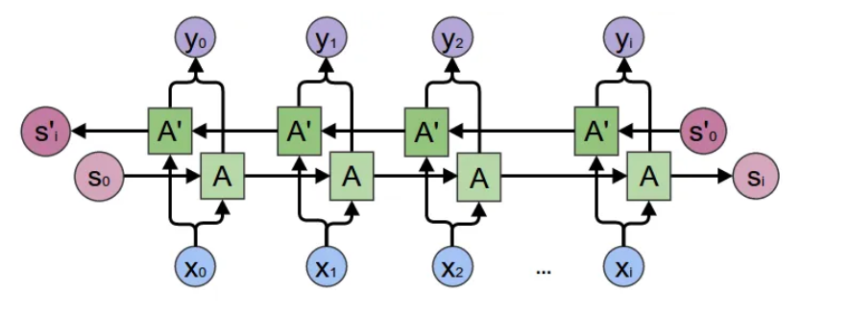
CNN-BiLSTM
BiLSTM:
Unlike the standard LSTM, the input flows in both directions, and it’s capable of utilizing information from both sides
BiLSTM adds one more LSTM layer, which reverses the direction of information flow. It means that the input sequence flows backward in the additional LSTM layer, followed by aggregating the outputs from both LSTM layers in several ways.
Every component of an input sequence has information from both the past and present and can thus produce a more meaningful output.

Slide 27
CNN-BiGRU
Bi-GRU:
GRU:
Gated Recurrent Unit is the same as the RNN but the difference is in the operation and gates associated with each GRU unit.
GRU incorporates the two gate operating mechanisms called Update gate and Reset gate.
Update gate:
The update gate is responsible for determining the amount of previous information that needs to pass along the next state.
Reset Gate:
The reset gate is used from the model to decide how much of the past information is needed to neglect.
GRU does not possess any internal memory, they don’t have an output gate that is present in LSTM

Slide 28
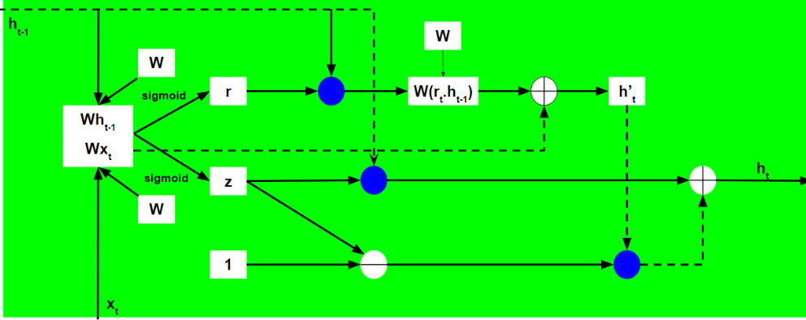
CNN-BiGRU

Slide 29
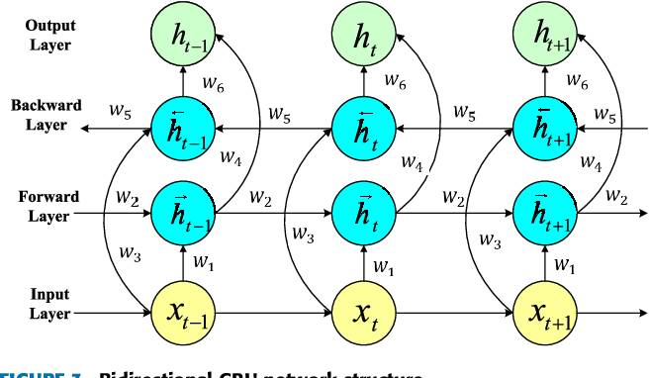
CNN-BiGRU
Bi-GRU:
Bi-GRU has two separate hidden states, one for each direction, and it concatenates the final hidden states from both directions before making its final prediction.
This allows the bi-GRU to capture information from both the past and the future of the input sequence, whereas a regular GRU only has access to information from the past.
It consists of less parameters as compare to Bi-LSTMs.

Slide 30
Without GloVe Embeddings
First, we trained our own word embeddings using the news training data via the Embedding layer of the Keras.
For custom word embeddings, we specified the vocabulary size of the training dataset, the sequence length of each padded text sequence, and the embedding dimensions of each token/word in the Embedding layer.
Our padded sequence length =300

Slide 31
Without GloVe Embeddings
For CNN-BiLSTM:
We first defined a 1-Dimensional convolutional layer with 128 filters and kernel size of 5 with a ‘relu’ activation function.
We then add a Bi-Directional LSTM layer with 200 hidden units and 0.25 dropout to help reduce overfitting.
We then added the following dense/fully-connected layers:
First dense layer with 64 units and relu activation.
Second dense layer with 32 units and relu activation.
Last dense layer with 20 units and sigmoid activation.
We used the adam optimizer function and and sparse crategorical cross entropy for optimizing the weights.

Slide 32
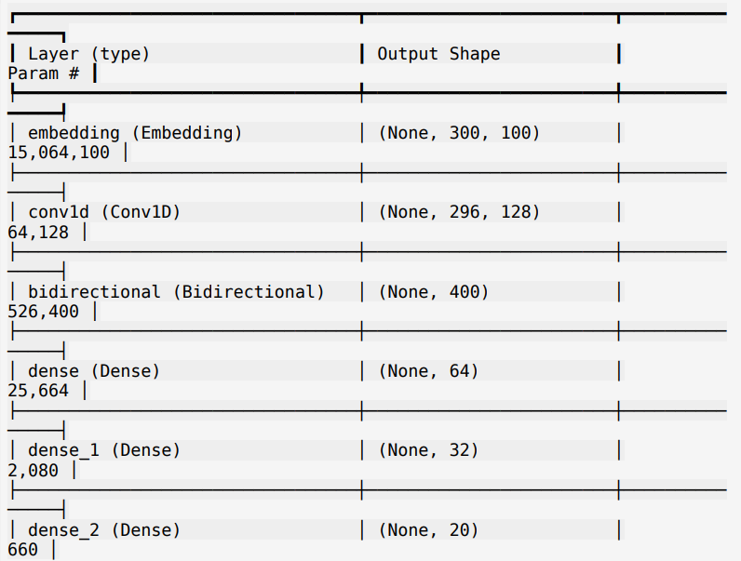
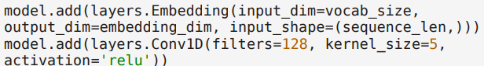
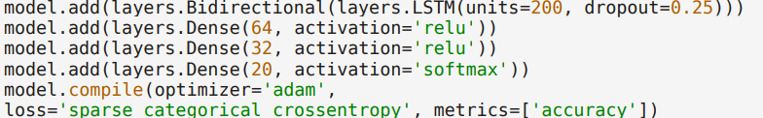
Without GloVe Embeddings
For CNN-BiLSTM:

Slide 33
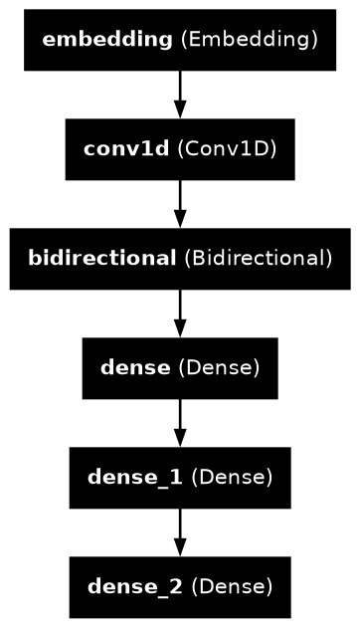
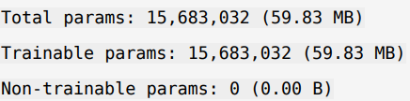
Without GloVe Embeddings
For CNN-BiLSTM:

Slide 34
Without GloVe Embeddings
For CNN-BiGRU:
We first defined a 1-Dimensional convolutional layer with 128 filters and kernel size of 5 with a ‘relu’ activation function.
We then add a Bi-Directional GRU layer with 200 hidden units and 0.25 dropout to help reduce overfitting.
We then added the following dense/fully-connected layers:
First dense layer with 64 units and relu activation.
Second dense layer with 32 units and relu activation.
Last dense layer with 20 units and sigmoid activation.
We used the adam optimizer function and and sparse crategorical cross entropy for optimizing the weights.

Slide 35
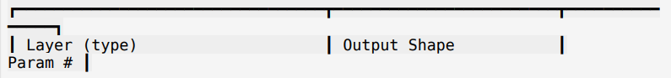
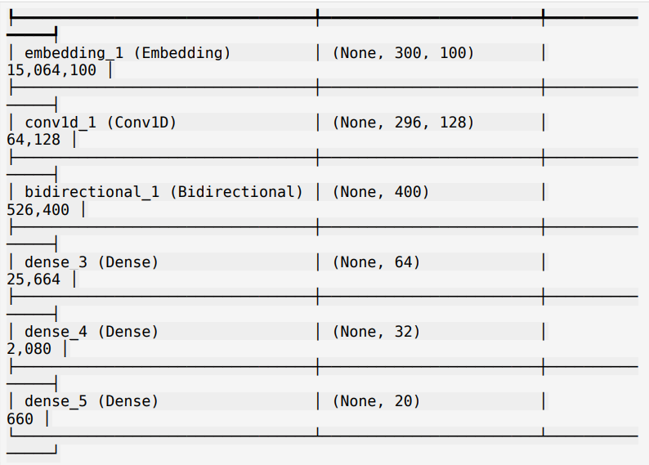
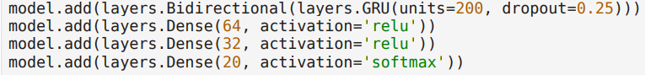
Without GloVe Embeddings
For CNN-BiGRU:

Slide 36
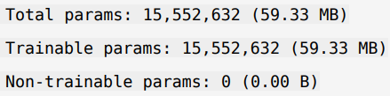
Without GloVe Embeddings
For CNN-BiGRU:

Slide 37
03.
Using GloVe embeddings

Slide 38
With GloVe Embeddings
We first created an embedding matrix using the downloaded pre-trained embeddings.
the downloaded GloVe embeddings was trained on Wikipedia/Gigaword Corpus having 6B tokens with 100 dimensions for each token.
We use the embedding matrix as pre-trained weights in the deep neural network.
For each word in the training data vocabulary, we checked whether the word exists in the pre-trained GloVe embeddings or not. If the word existed, we added its GloVe embedding in the corresponding index of the embedding matrix, else, we simply added zero vectors.

Slide 39
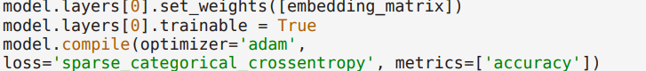
With GloVe Embeddings
After defining the embedding matrix, we used the previous neural networks and added weights in the embedding layer corresponding to the embedded matrix and set those weights as trainable so as to fine-tune the weights according to our specific task of classification

Slide 40
Training and Validation
Model Training : We used an adam optimizer with a learning rate of 0.001 and a batch size of 128 over 20 epochs for each model.
Accuracy and Loss Metrics: Through graphs, we visually represent the training and validation accuracy and loss over the epochs. This visualization highlights the models' learning progress and effectiveness in minimizing errors, offering insights into their performance stability and improvement areas.
GloVe Embeddings: Impact: A comparison of model performances with and without GloVe embeddings showcases the significant improvement in accuracy when using pre-trained word vectors. This demonstrates the value of incorporating rich semantic knowledge into the models, leading to better text classification results.

Slide 41
Experimental Results
In our study, we explored the performance of CNN-BiLSTM and CNN-BiGRU models in text classification, emphasizing the influence of GloVe embeddings. The integration of GloVe notably enhanced model accuracy, with CNN-BiLSTM's validation accuracy jumping from 67.5% to 76.8%, and CNN-BiGRU seeing an increase from 64.7% to approximately 76%. This demonstrates the profound impact of leveraging pre-trained embeddings on the models' ability to understand and classify complex text data accurately.
The improvement underscores GloVe's role in providing a deep semantic understanding of text, which is crucial for accurate classification. By embedding words into a rich vector space, GloVe allows the models to capture nuanced meanings and relationships, significantly contributing to their enhanced performance.
These results affirm the hypothesis that incorporating GloVe embeddings can substantially improve the efficacy of neural network models in multi-label text classification tasks, showcasing the potential for more accurate and reliable NLP applications.

Slide 42
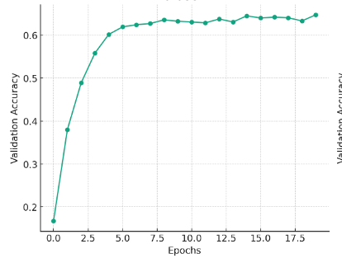
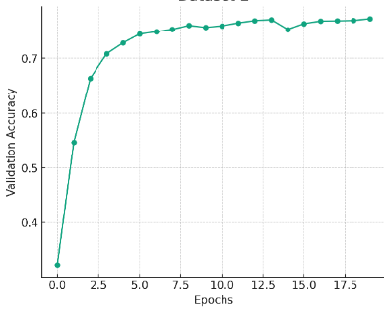
Accuracy
cnn-bilstm-without-glove
cnn-bilstm-with-glove

Slide 43
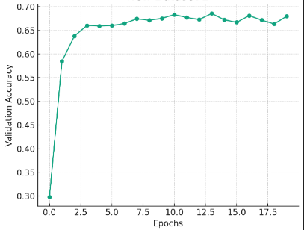
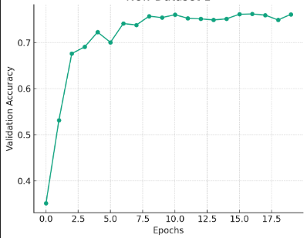
Accuracy
cnn-bigru-without-glove
cnn-bigru-with-glove

Slide 44
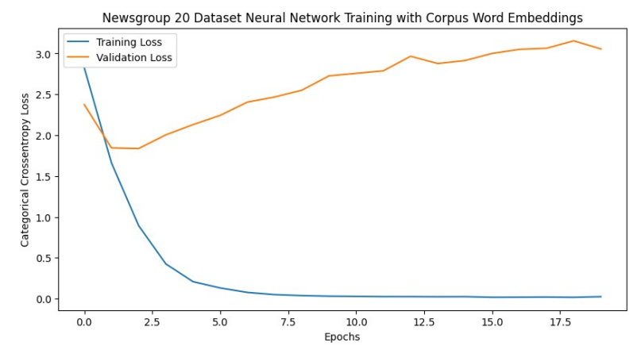
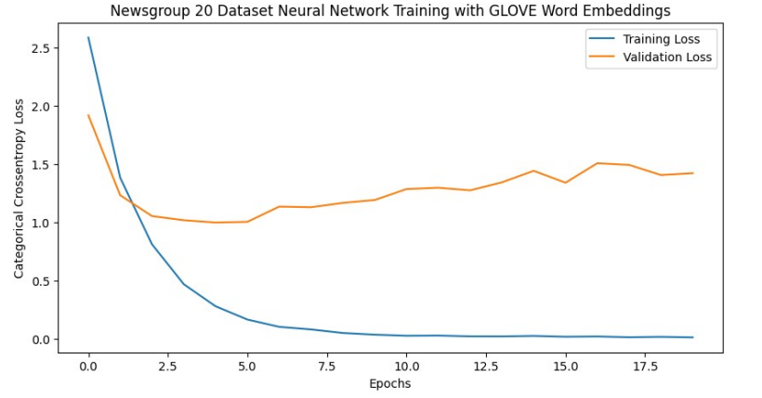
Loss
cnn-bigru-without-glove-loss
cnn-bigru-with-glove-loss

Slide 45
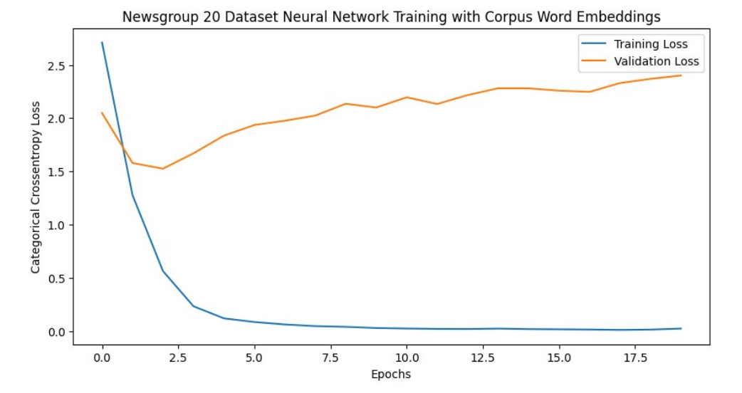
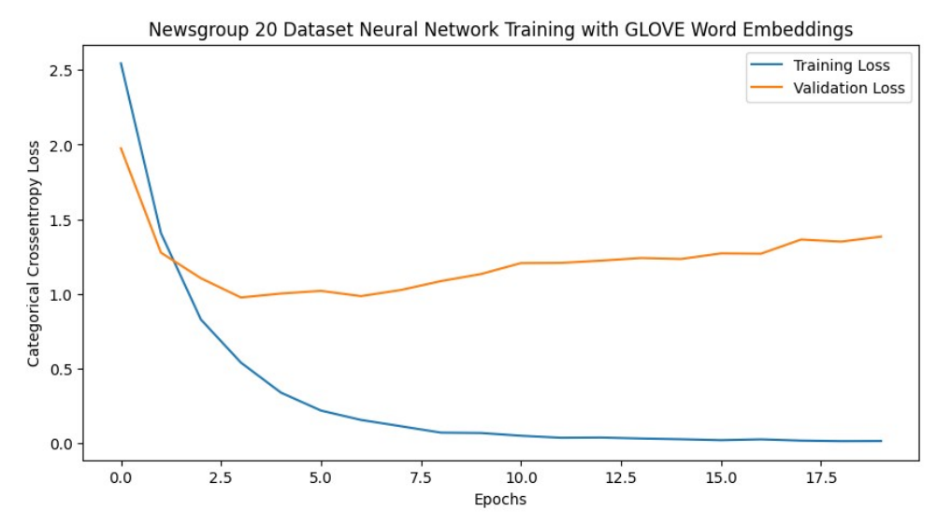
Loss
cnn-bilstm-without-glove-loss
cnn-bilstm-with-glove-loss

Slide 46
Challenges and Solutions
Throughout our project, we navigated through several challenges:
Overfitting: Our models were too attuned to training data, compromising their ability to generalize. Solution: We integrated dropout layers and implemented early stopping to promote generalizability, reducing overfitting significantly.
Computational Demand: The model complexity and data volume demanded extensive computational resources, leading to lengthy training periods.
Solution: By refining our models and leveraging GPU acceleration, we enhanced computational efficiency enabling quicker training cycles.
Data Imbalance: The dataset exhibited sparsity and imbalance, risking model bias. Solution: Techniques like data augmentation and class weighting helped us achieve more balanced training and improved accuracy across various labels.
These measures effectively addressed the key challenges, ensuring our models' robustness and reliability in classifying multi-label texts.

Slide 47
Conclusion and Future Work
Conclusion:
Our study illustrates the impactful role of GloVe embeddings in enhancing CNN-BiLSTM and CNN-BiGRU models for text classification, leading to notable accuracy improvementsnot,only improved model accuracy but also enhanced their ability to understand complex text semantics. This reinforces the significance of leveraging pre-trained embeddings for deep linguistic understanding in NLP tasks.
Future Work:
Exploring Embeddings: We aim to test the efficacy of different embeddings like FastText and BERT to further enhance text comprehension.
Tackling Overfitting: Implementing advanced regularization methods will be a priority to ensure our models generalize well.
Optimization Advances: We plan to explore newer optimization strategies to boost training efficiency and model performance.

Slide 48
References
Wang, H. (2023). "Multi-label Text Classification using GloVe and Neural Network Models," arXiv preprint arXiv:2312.03707.
Pennington, J., Socher, R., & Manning, C. D. (2014). "GloVe: Global Vectors for Word Representation," in Proceedings of the 2014 Conference on Empirical Methods in Natural Language Processing (EMNLP).
Mohammed, H. H., Dogdu, E., Görür, A. K., & Choupani, R. (2020). "Multi-Label Classification of Text Documents Using Deep Learning," 2020 IEEE International Conference on Big Data (Big Data), pp. 4681-4689.
Wang, S., Yang, Y., & Meng, X. (2022). "Research on Multi-Label Text Classification Based on Multi-Channel CNN and BiLSTM," 2022 International Conference on Artificial Intelligence of Things and Crowdsensing (AIoTCs), pp. 498-503.

Slide 49
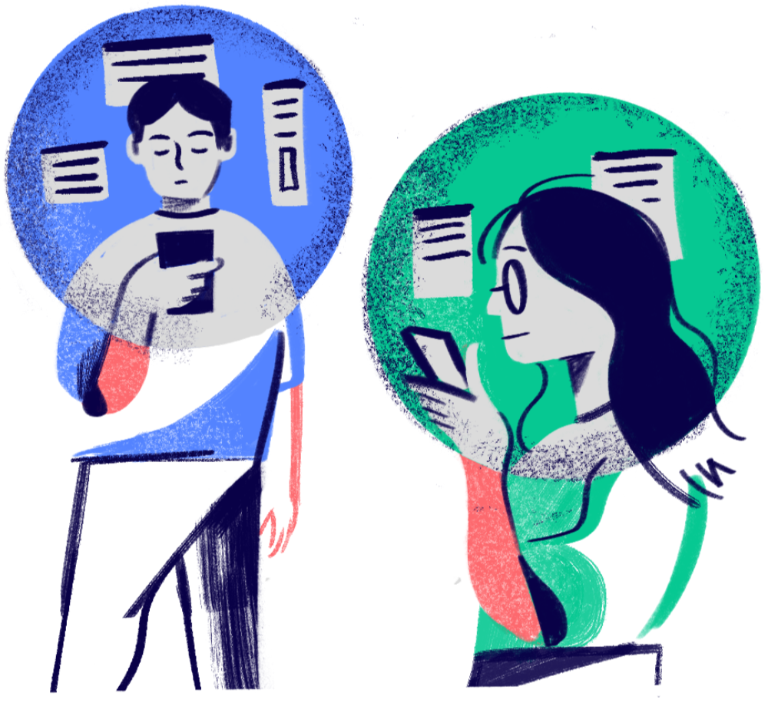
PRESENTED BY GROUP-20
THANK YOU VERY MUCH!

